Slide 1


Stock Trading & Investment Performance Analytics System
HOME
ABOUT
CONCLUSION
CONTACT
- Rayapudi Rithika

Slide 2
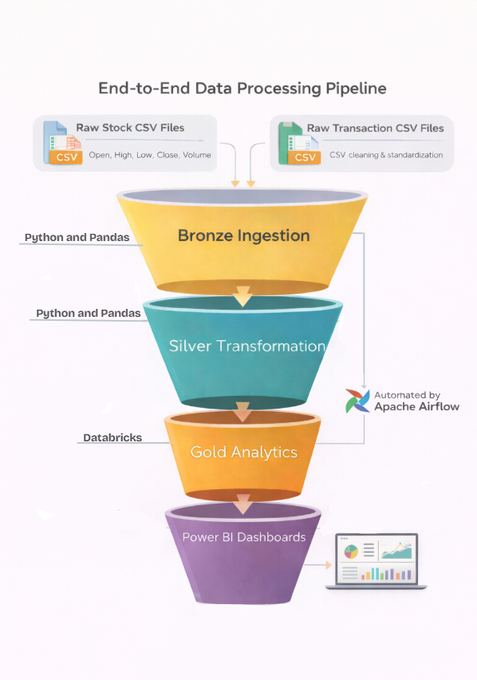
Workflow
Project Overview
This project focuses on building an automated analytics system for stock market and portfolio data
The system processes raw stock prices and trading transactions into analytics-ready insights
Emphasis is placed on:
Data quality and consistency
Automated workflow execution
Scalable analytics
Business-oriented visualization
The solution mirrors real-world financial analytics pipelines used in industry

Slide 3

Problem Context
HOME
Stock market data is time-series based and sensitive to missing or irregular trading days
Manual analysis is not scalable and often inconsistent
Portfolio data is usually fragmented across multiple files
There is a need for:
Automated processing
Reliable return and risk calculations
A consolidated analytical view

Slide 4

Data Scope and Technology Stack
Data Scope:
Daily stock price data for:
AAPL, MSFT, GOOGL
Attributes processed:
Open, High, Low, Close, Volume
Simulated portfolio transaction data:
Buy/Sell trades, quantity, trade price
Data handled entirely using structured CSV-based workflows
Technology Stack: Python, Pandas, NumPy, Apache Airflow, Databricks, CSV-based storage, Power BI

Slide 5
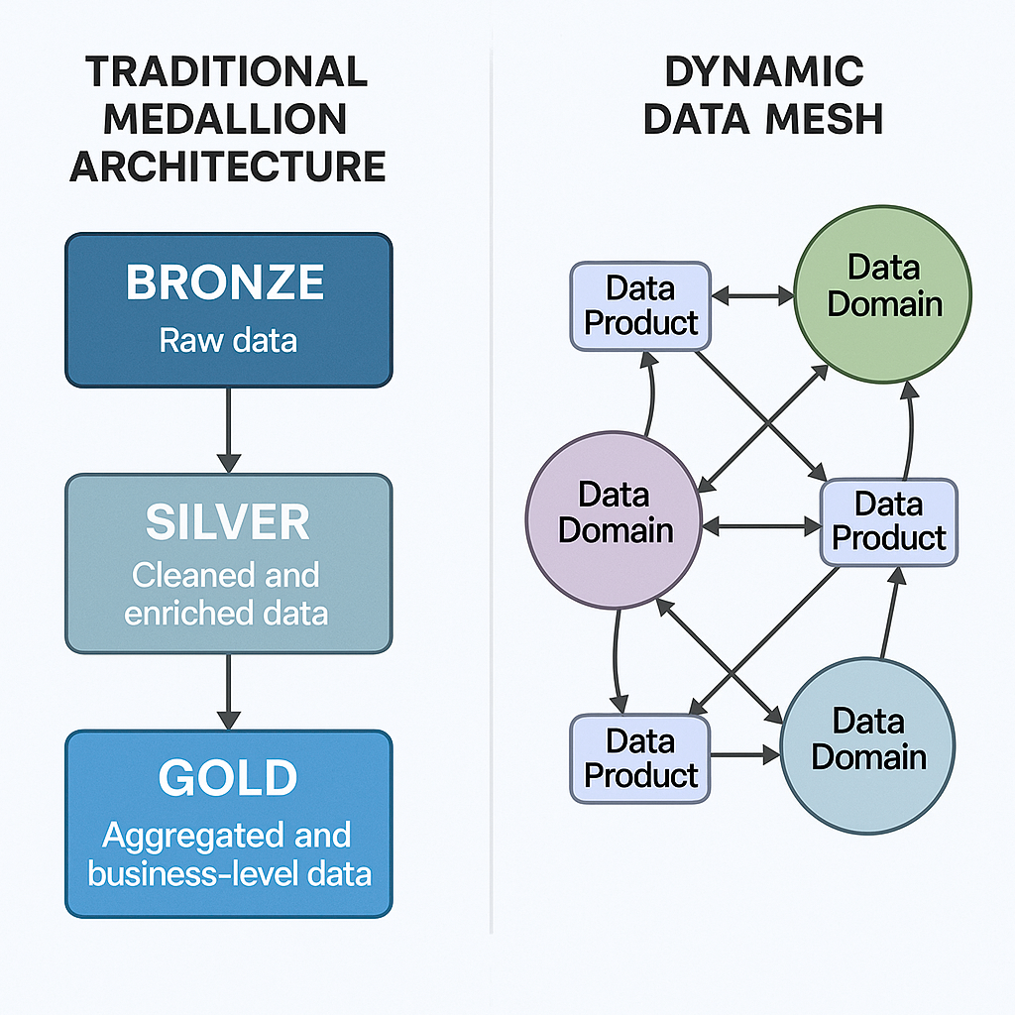
Pipeline Architectcure
Data quality
The solution follows the Medallion Architecture:
Bronze: Raw data ingestion
Silver: Cleaning and standardization
Gold: Aggregated analytics
Apache Airflow orchestrates the execution of all layers
Azure Databricks is used for scalable analytics processing
Power BI consumes gold-layer outputs for visualization

Slide 6
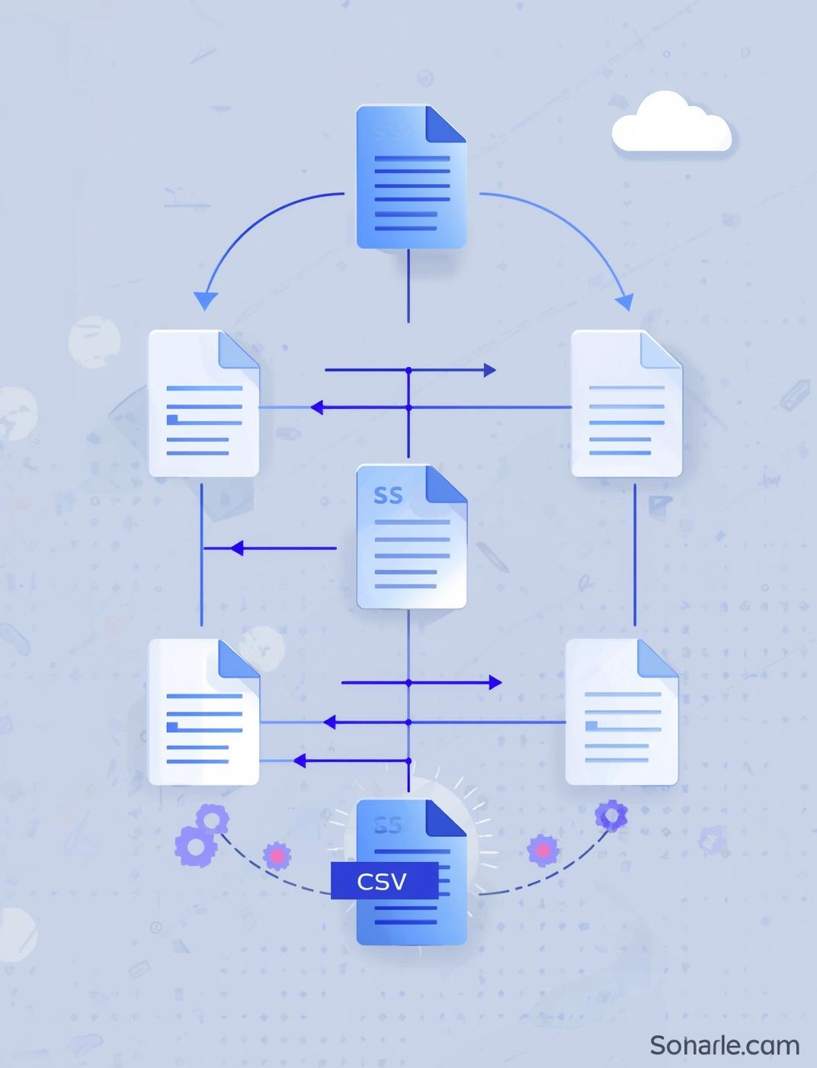
Bronze Layer: Data Ingestion
Individual stock CSV files (AAPL, MSFT, GOOGL) are loaded using Pandas
Each dataset is tagged with a stock identifier column
All stock datasets are merged into a single DataFrame
Portfolio transaction data is ingested separately from CSV files
Data is written to processed storage without cleansing or calculations

Slide 7
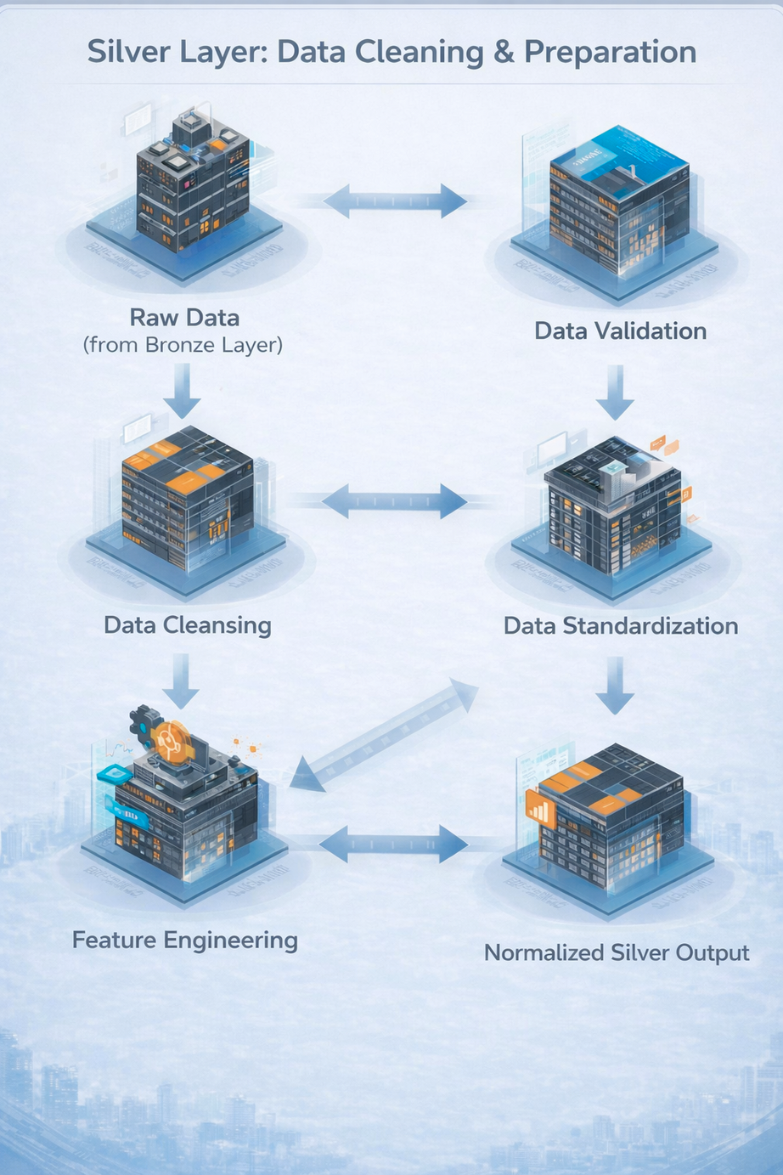
Silver Layer: Data Cleaning & Preparation
CONTACT
Data type standardization and date parsing are applied
Records are sorted by stock and trading date
Missing values in price and volume columns are handled
Time-series continuity is maintained for return calculations
Derived metrics are computed:
Daily returns
Cumulative returns
Moving averages

Slide 8

Portfolio Transaction Processing
Raw transaction data is ingested using Python
Invalid records are removed based on:
Missing trade dates
Invalid quantities or prices
Incorrect trade types
Cleaned transaction data is prepared for portfolio analytics
Enables accurate investment and profit/loss analysis

Slide 9
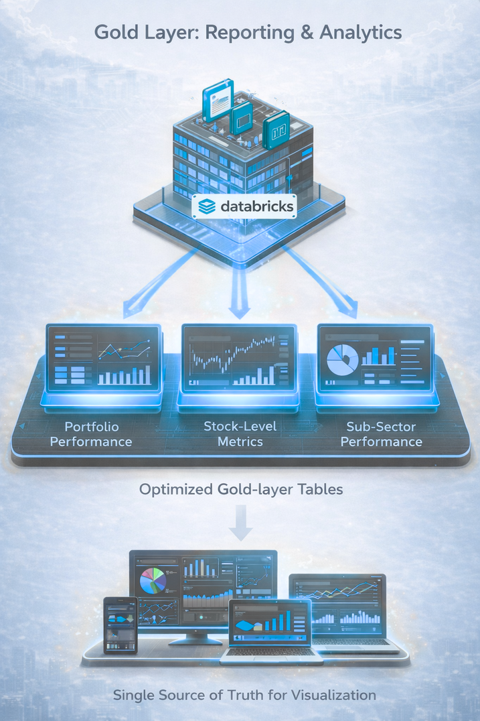
Gold Layer:
Analytical Processing
CONTACT
Databricks notebooks are used for analytical transformations
Aggregations and summaries are generated for:
Portfolio performance and profit/loss
Stock-level performance metrics
Sub-sector performance analysis
Gold-layer tables are optimized for reporting and dashboards
Outputs serve as a single source of truth for visualization

Slide 10
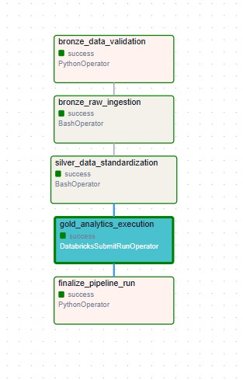
Workflow Automation & Monitoring
Apache Airflow DAG orchestrates the entire pipeline
Tasks include:
Bronze ingestion
Silver transformation
Gold analytics execution
Airflow provides:
Scheduling
Dependency management
Retries and failure handling
Execution logs for monitoring

Slide 11

Visualization & Reporting
Power BI dashboards are built on gold-layer datasets
Dashboards provide insights into:
Stock trends and returns
Portfolio allocation and performance
Trading activity
Risk and market indicators
Visuals are designed for clarity and business interpretation

Slide 12
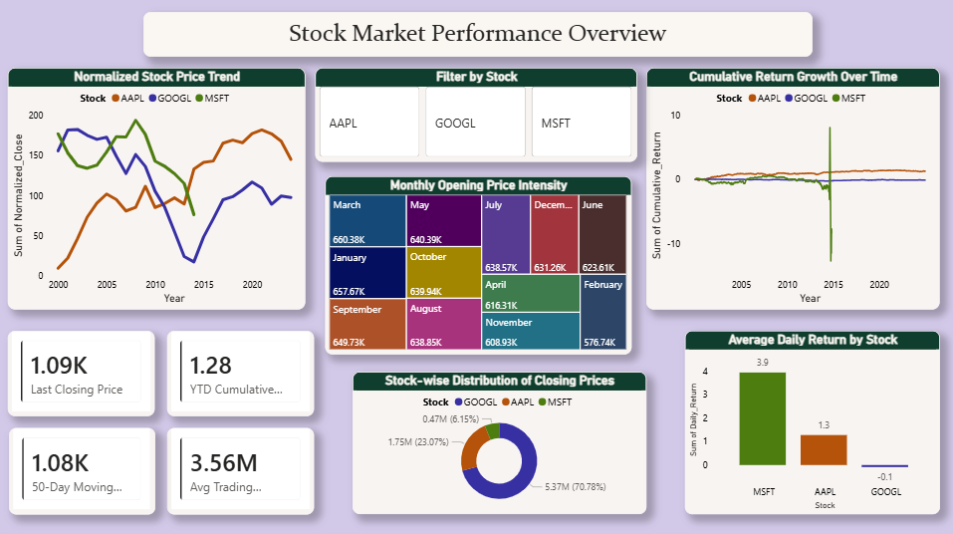
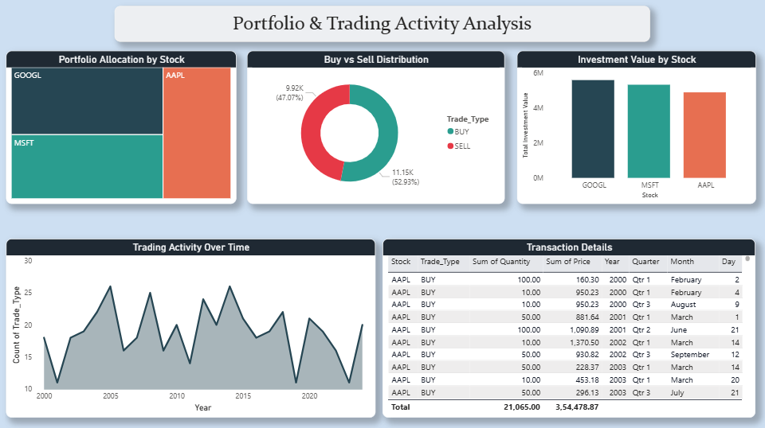
Dashboards
Stock Market Performance Overview
Provides a consolidated view of stock price trends, cumulative returns, and trading activity across selected stocks to understand overall market behaviour.
Portfolio & Trading Activity Analysis
Analyzes portfolio allocation, buy vs sell distribution, and trading frequency to evaluate investment behavior and transaction patterns.

Slide 13
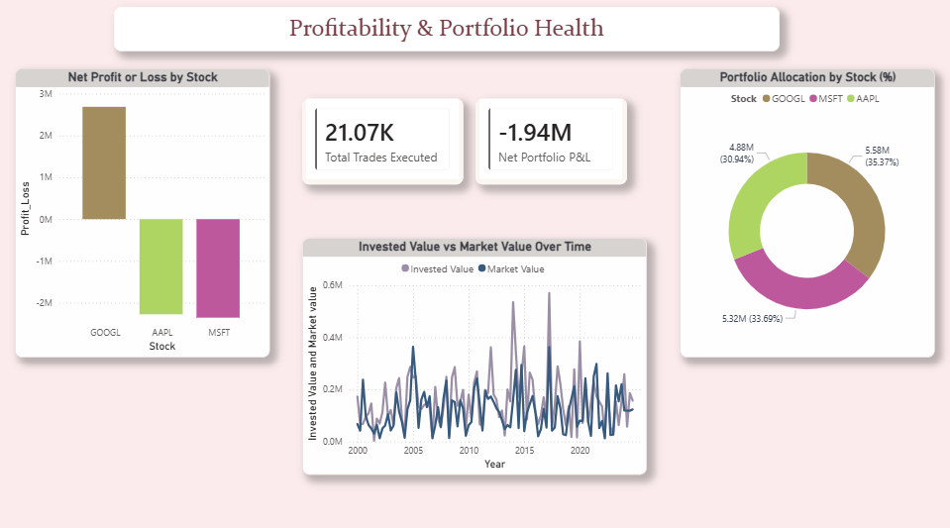
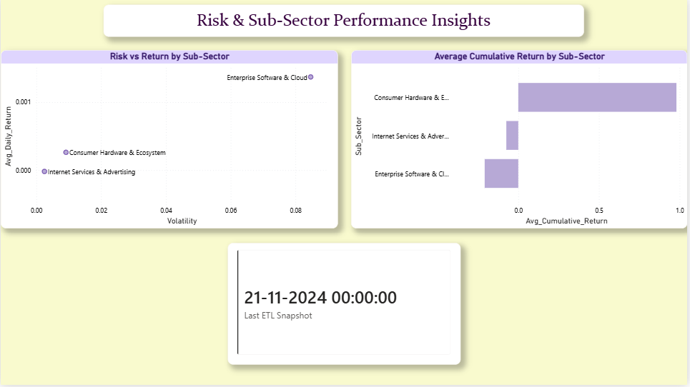
Dashboards
Profitability & Portfolio Health
Highlights portfolio profit or loss, invested versus market value trends, and overall portfolio health across stocks.
Risk & Sub-Sector Performance Insights
Compares risk, return, and cumulative performance across sub-sectors to identify stable and high-risk investment areas

Slide 14

Conclusion
This project demonstrates a complete end-to-end analytics system for stock trading and investment performance analysis
Raw stock price and portfolio transaction data are systematically transformed into analytics-ready datasets using a layered pipeline
The Medallion Architecture ensures clear separation between ingestion, cleaning, and analytical processing
Apache Airflow enables automated, repeatable, and monitored execution of the pipeline
Power BI dashboards convert processed data into actionable insights related to market trends, portfolio health, returns, and risk

Slide 15

Future Scope
Integration of real-time market data APIs for near real-time analytics
Expansion to include additional stocks, indices, or asset classes
Predictive analytics using machine learning models for return forecasting
Deployment on cloud-native data platforms

Slide 16
Thank you

